Slide 1
Stock Market Trend Prediction Using K-Nearest Neighbor(KNN) Algorithm

Slide 2
Abstract
This paper examines a hybrid model which combines a K-Nearest Neighbors (KNN) approach with a probabilistic method for the prediction of stock price trends. One of the main problems of KNN classification is the assumptions implied by distance functions. The assumptions focus on the nearest neighbors which are at the centroid of data points for test instances. This approach excludes the non-centric data points which can be statistically significant in the problem of predicting the stock price trends. For this it is necessary to construct an enhanced model that integrates KNN with a probabilistic method which utilizes both centric and non-centric data points in the computations of probabilities for the target instances. The embedded probabilistic method is derived from Bayes’ theorem. The prediction outcome is based on a joint probability where the likelihood of the event of the nearest neighbors and the event of prior probability occurring together and at the same point in time where they are calculated. The proposed hybrid KNNProbabilistic model was compared with the standard classifiers that include KNN, Naive Bayes, One Rule (OneR) and Zero Rule (ZeroR). The test results showed that the proposed model outperformed the standard classifiers which were used for the comparisons.

Slide 3
Existing System
A nearest neighbor search (NNS) method produced an intended result by the use of KNN technique with technical analysis. This model applied technical analysis on stock market data which include historical price and trading volume. It applied technical indicators made up of stop loss, stop gain and RSI filters. The KNN algorithm part applied the distance function on the collected data. This model was compared with the buy-and-hold strategy by using the fundamental analysis approach.

Slide 4
Proposed System
. Stock market prediction is an act of trying to determine the future value of a stock other financial instrument traded on a financial exchange. The programming language is used to predict the stock market using machine learning is Python. In this paper we propose a Machine Learning (ML) approach that will be trained from the available stocks data and gain intelligence and then uses the acquired knowledge for an accurate prediction. In this context this study uses a machine learning technique called K-Nearest Neighbor to predict stock prices for the large and small capitalizations and in the three different markets, employing prices with both daily and up-to-the-minute frequencies.

Slide 5
System Requirements
Hardware Requirements
Processor –i3 or Above
RAM -2GB
Hard Disk-5GB

Slide 6
Software Requirements
Operating System :Windows10
Programing Language :Python3

Slide 7
Modules
Tkinter
Pandas
Matplotlib
Numpy
Sklearn
Imutils
seaborn

Slide 8
Tkinter
Tkinter is a Python binding to the Tk GUI toolkit. It is the standard Python interface to the Tk GUI toolkit, and is Python's de facto standard GUI. Tkinter is included with standard Linux, Microsoft Windows and Mac OS X installs of Python. The name Tkinter comes from Tk interface.

Slide 9
Pandas
Pandas is an open-source, Python library providing high-performance, easy-to-use data structures and data analysis tools for the Python programming language. Python with Pandas is used in a wide range of fields including academic and commercial domains including finance, economics, Statistics, analytics, etc.

Slide 10
Numpy
NumPy, which stands for Numerical Python, is a library consisting of multidimensional array objects and a collection of routines for processing those arrays. Using NumPy, mathematical and logical operations on arrays can be performed. This tutorial explains the basics of NumPy such as its architecture and environment. It also discusses the various array functions, types of indexing, etc. An introduction to Matplotlib is also provided. All this is explained with the help of examples for better understanding.

Slide 11
Matplotlib
matplotlib is probably the single most used Python package for 2D-graphics. It provides both a very quick way to visualize data from Python and publication-quality figures in many formats. We are going to explore matplotlib in interactive mode covering most common cases.

Slide 12
Sklearn
There are several Python libraries which provide solid implementations of a range of machine learning algorithms. One of the best known is Scikit-Learn, a package that provides efficient versions of a large number of common algorithms. Scikit-Learn is characterized by a clean, uniform, and streamlined API, as well as by very useful and complete online documentation. A benefit of this uniformity is that once you understand the basic use and syntax of Scikit-Learn for one type of model, switching to a new model or algorithm is very straightforward.
This section provides an overview of the Scikit-Learn API; a solid understanding of these API elements will form the foundation for understanding the deeper practical discussion of machine learning algorithms and approaches in the following chapters.

Slide 13
Imutils
A series of convenience functions to make basic image processing functions such as translation, rotation, resizing, skeletonization, displaying Matplotlib images, sorting contours, detecting edges, and much more easier with OpenCV and both Python 2.7 and Python 3.

Slide 14
seaborn
Seaborn is a Python data visualization library based on matplotlib.
It provides a high-level interface for drawing attractive and informative statistical graphics.

Slide 15
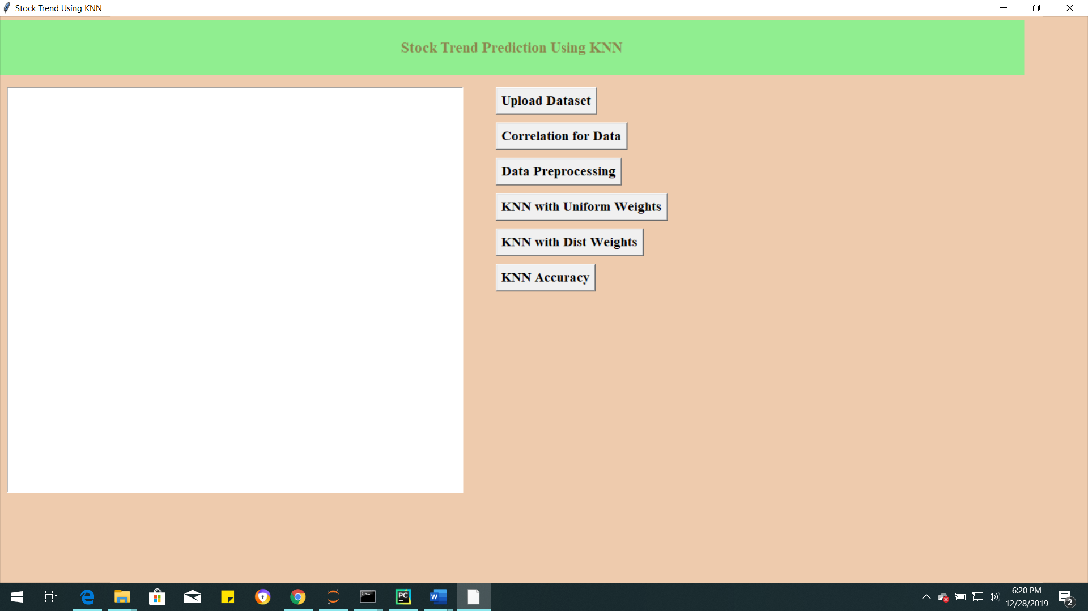
Screens

Slide 16
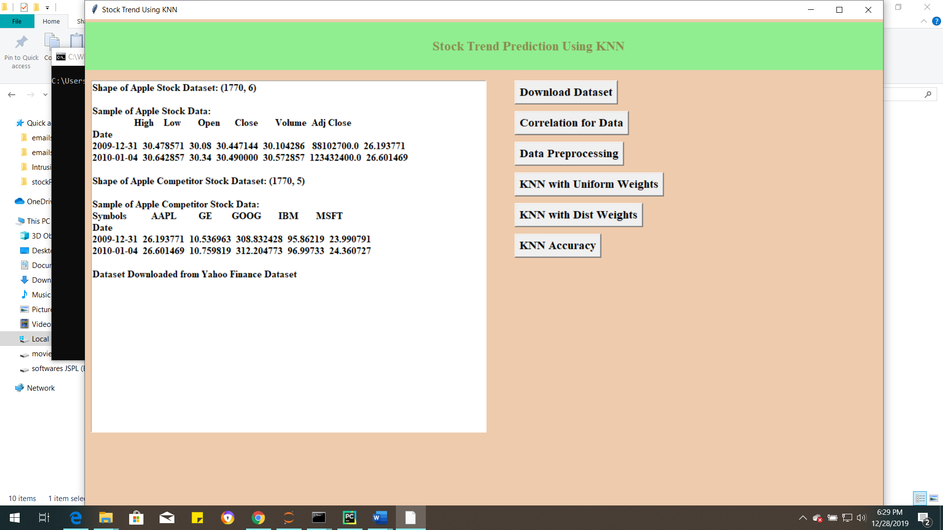
Download Dataset

Slide 17
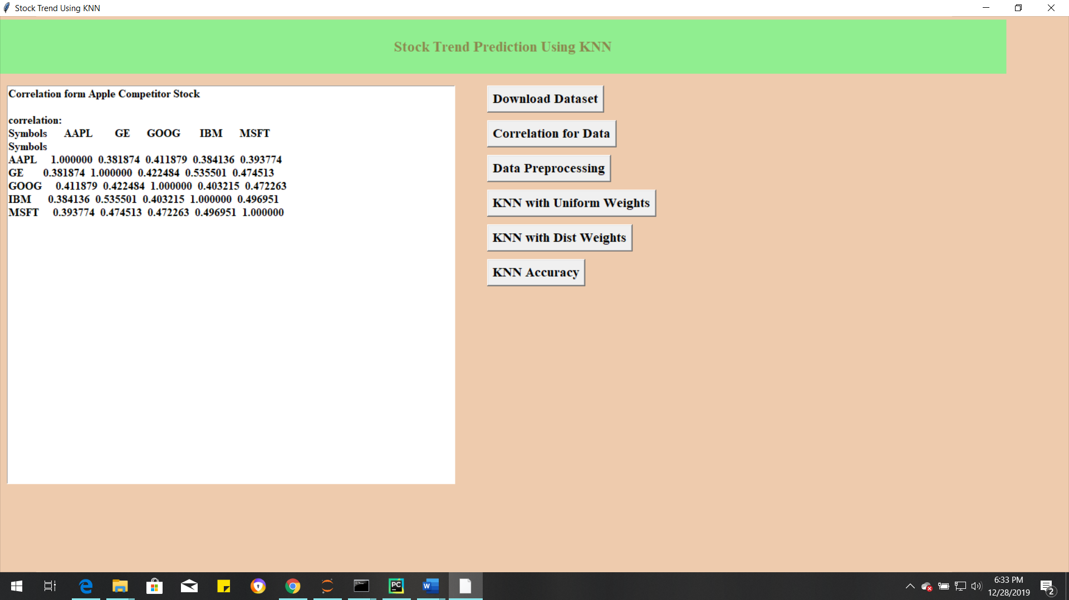
Correlation For Data

Slide 18
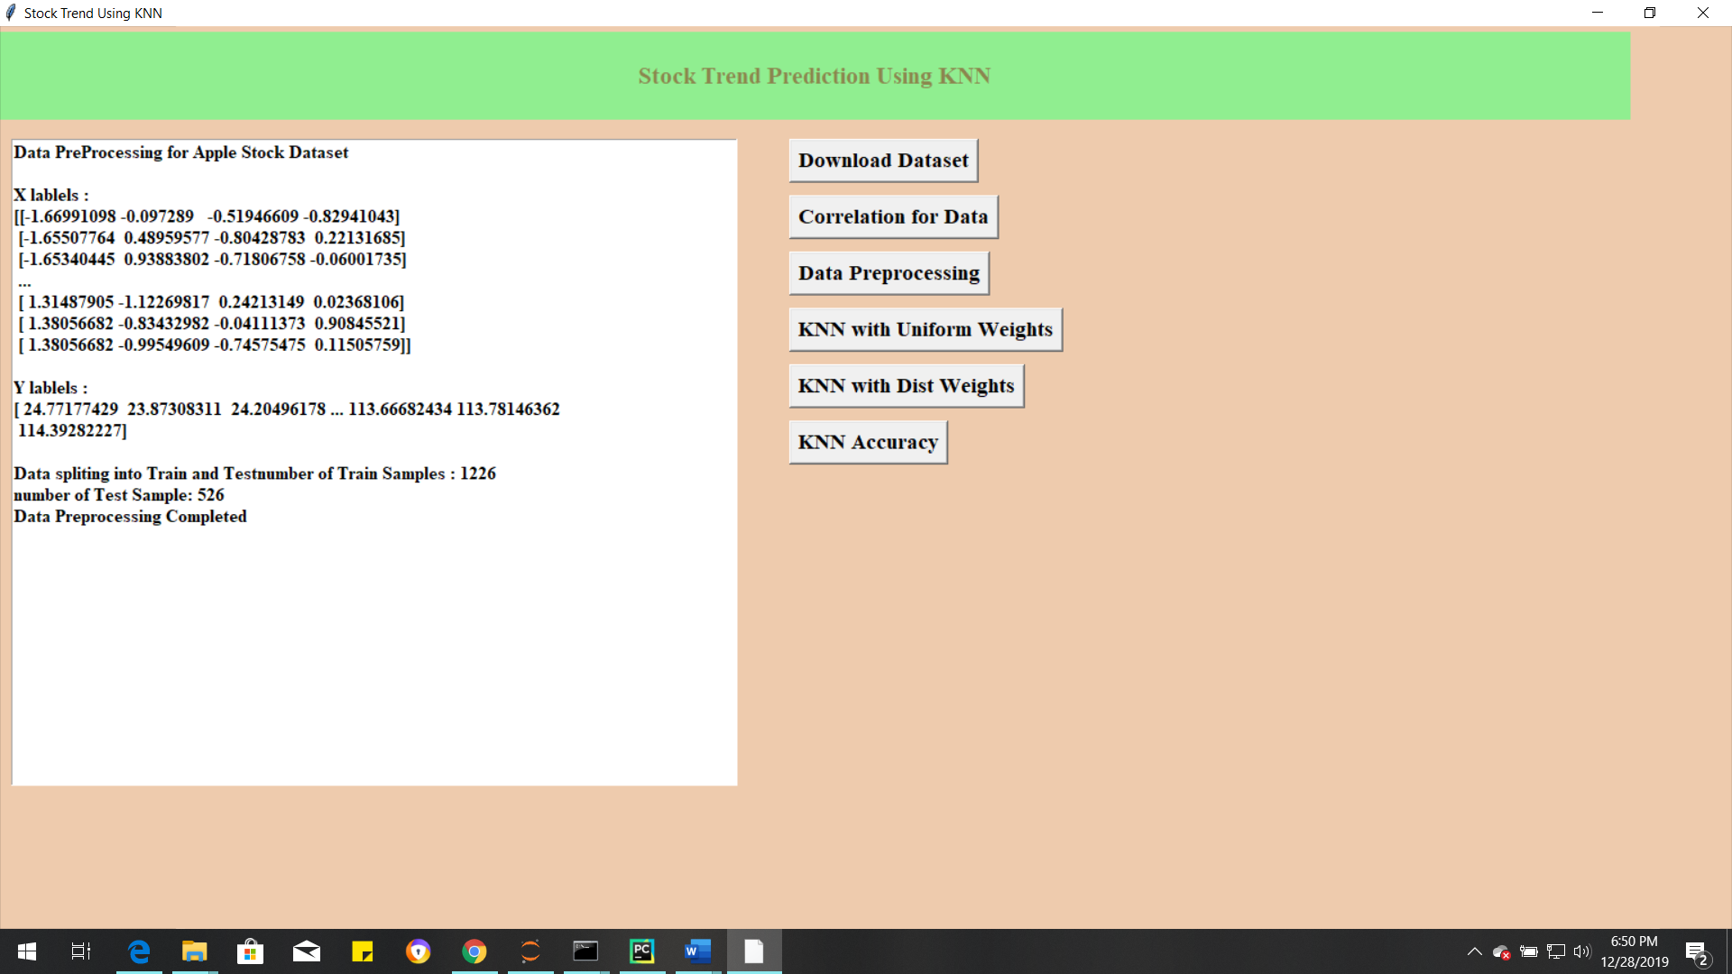
Data Preprocessing

Slide 19
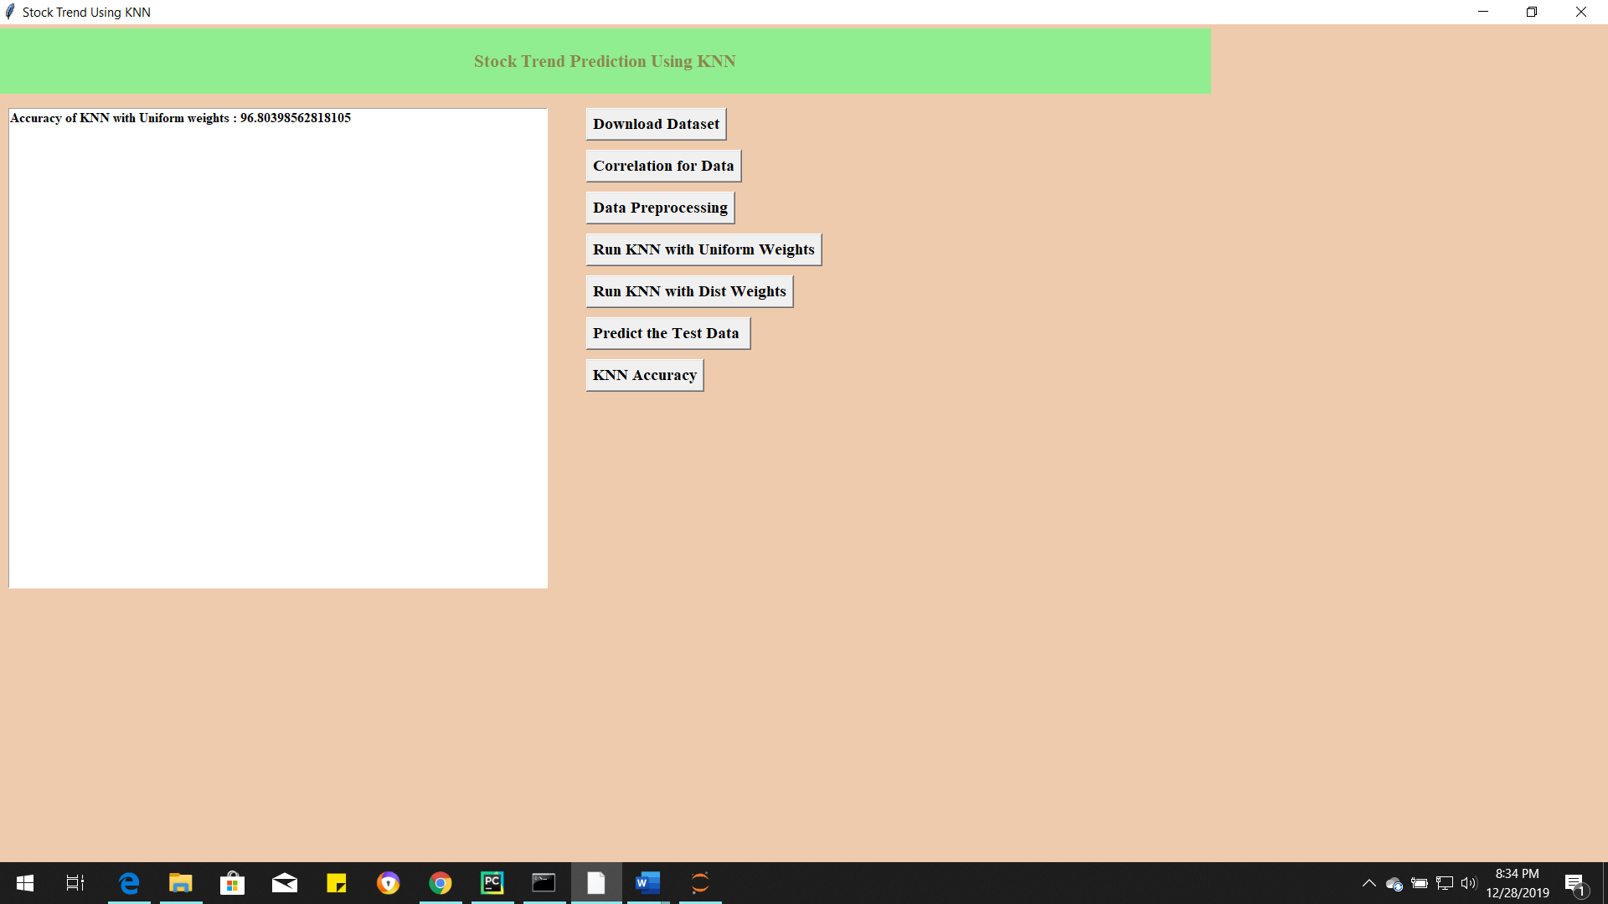
KNN With uniform Weight

Slide 20
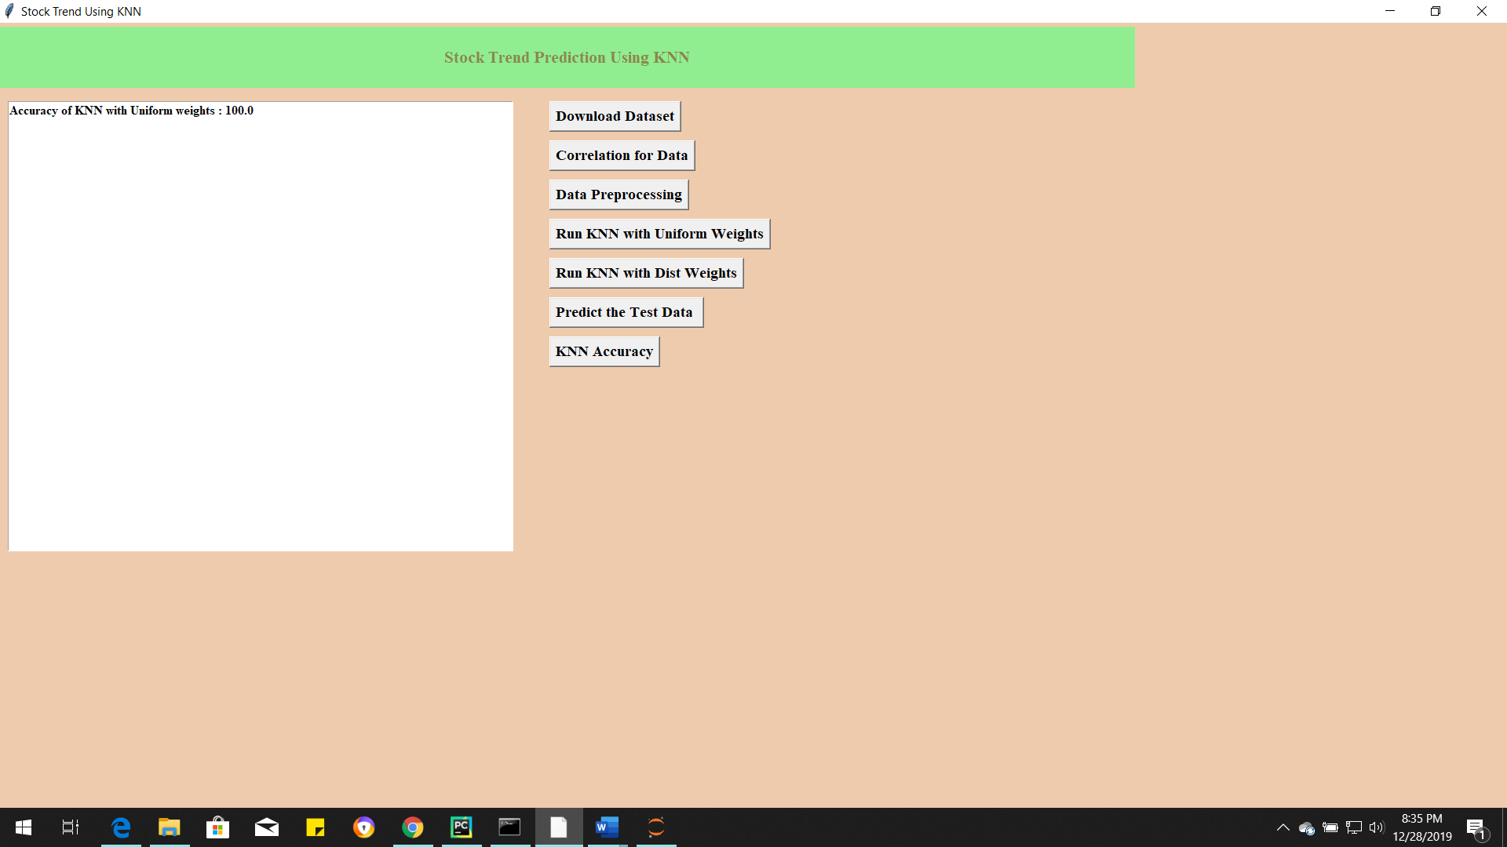
Run KNN with Different Weights

Slide 21
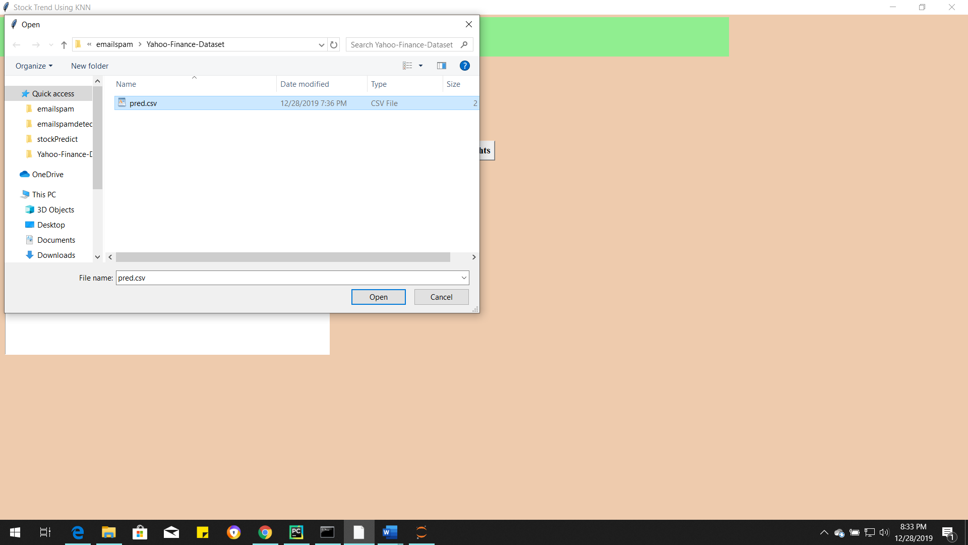
Test Data Upload

Slide 22
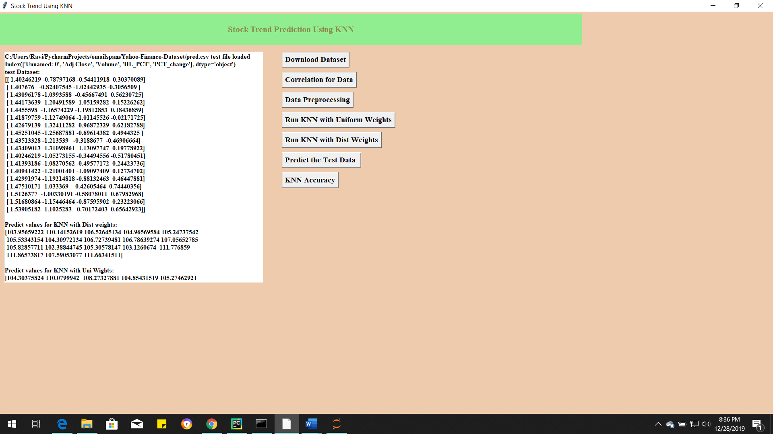
Test data Results

Slide 23
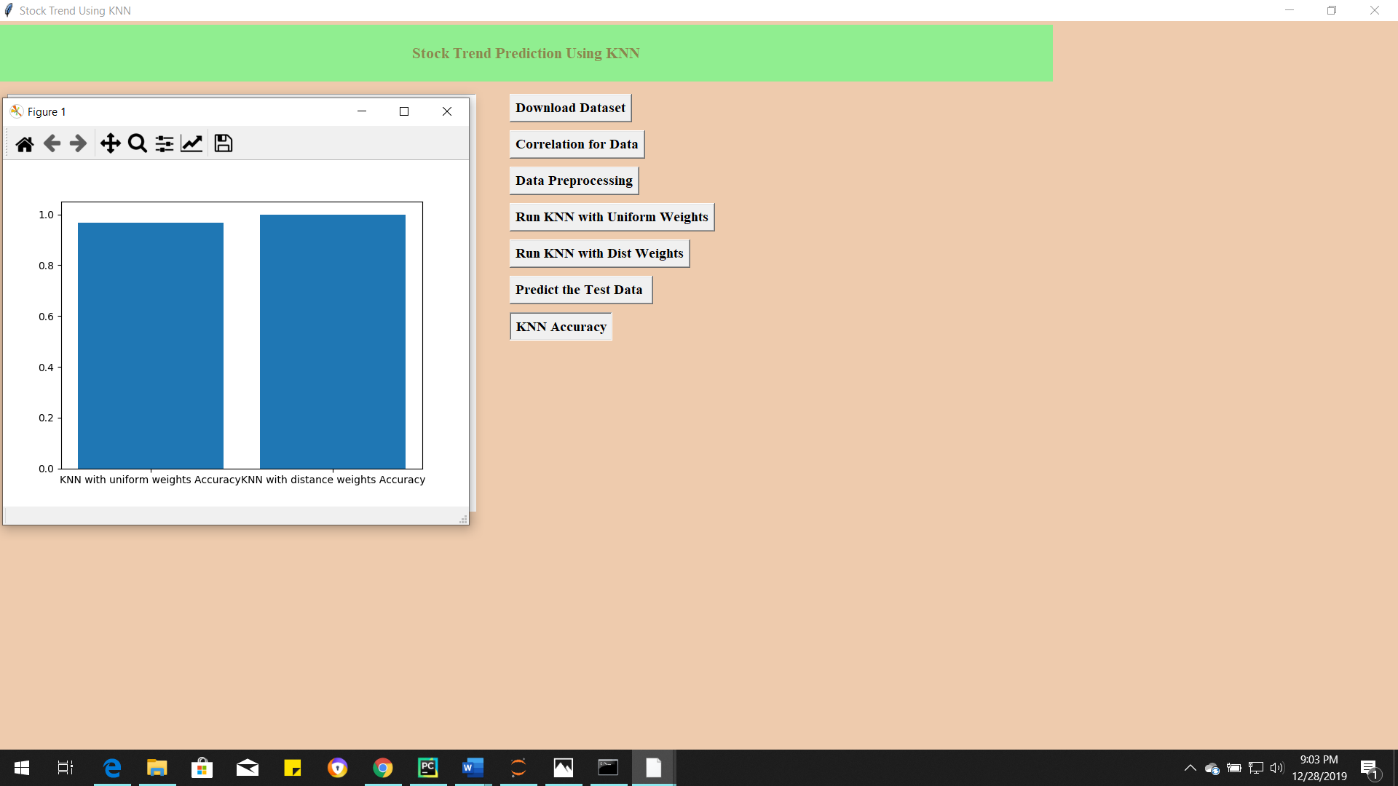
KNN Accuracy

Slide 24
Conclusion
The aim of this research is to improve the statistical fitness of the proposed model to overcome a KNN problem due to its computation approach. The KNN classifier can compute the empirical distribution over the Profit and Loss class values in the k number of nearest neighbors. However, the outcome is less than adequate due to sparse data. The KNN classifier has underfitting issue as it does not cater to generalization of sparse data outside the range of nearest neighborhood. We have compared a hybrid KNN Probabilistic model with four standard algorithms on the problem of predicting the stock price trends. Our results showed that the proposed KNN Probabilistic model leads to significantly better results compared to the standard KNN algorithm and the other classification algorithms.

Slide 25
Thank You

Slide 26
Any Queries

